Slide 1
Collection and SOQL Assignment

Slide 2
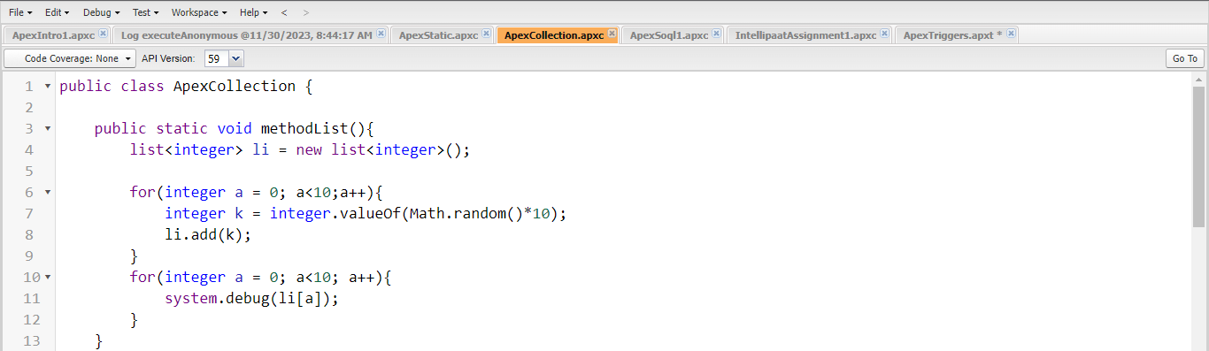
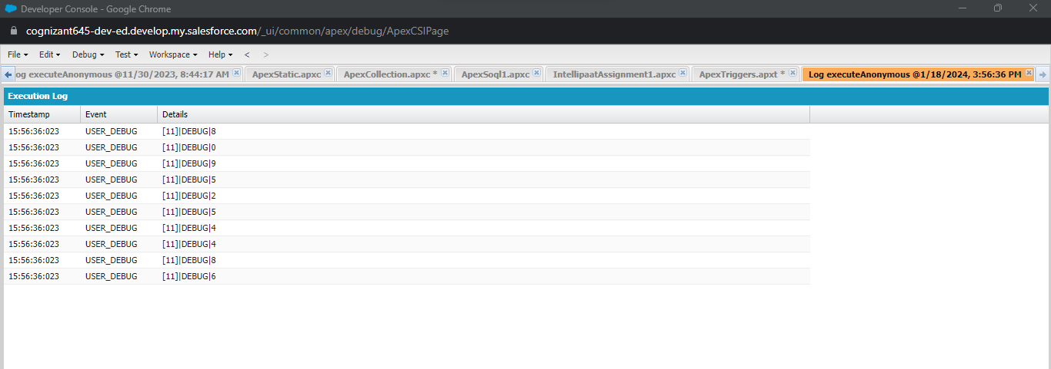
1)
Add the values to the list
Retrieve the values from list using index

